Slide 1




Presentation on Project & Thesis
Course No: ESE 4000
THESIS TITLE: IMPLEMENTING IOT-BASED FAULT DETECTION AND MONITORING IN SOLAR POWER PLANTS USING MACHINE LEARNING AND DIGITAL TWIN TECHNOLOGY
Supervised by:
Presented By :
Nibir Mondol
Bidut Sharkar Shemanto
4th Year 1st Semester
Department of Energy Science and Engineering
Student ID: 1913027
Assistant Professor
Department of Energy Science and Engineering
Khulna University of Engineering & Technology (KUET), Khulna -9203
26th December | 2024

Slide 2
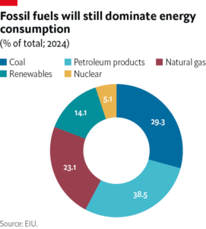
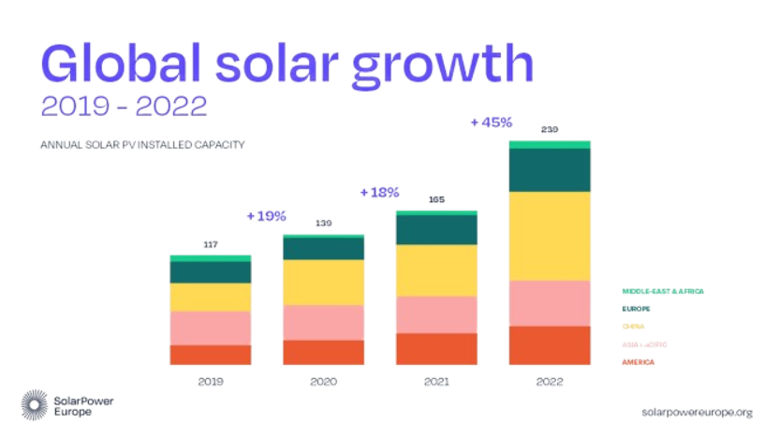
INTRODUCTION
During the last decade, the rise of renewable energy (RE) sources has accelerated and solar energy take the majority share of it
IN 2023,the world deployed 447 GW of new solar PV capacity last year; an incredible 87% more than 2022
Figure 1: World wide energy usage source wise
Figure 2: Global solar growth(2018-22)

Slide 3
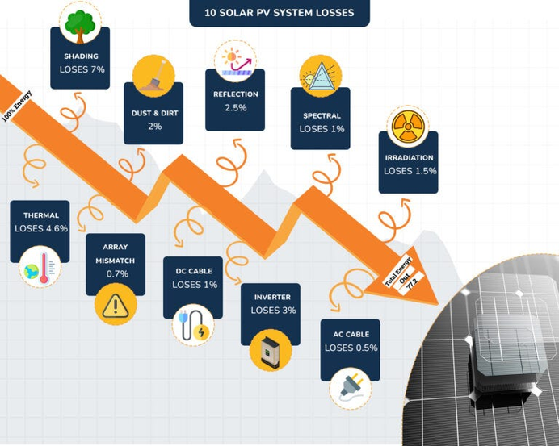
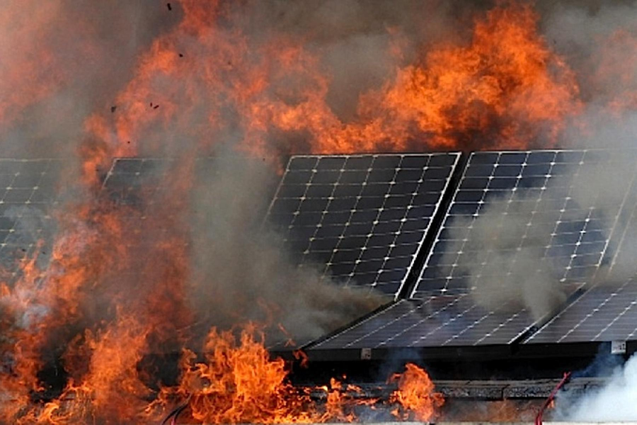
INTRODUCTION
(Cont’D)
A fault in a photovoltaic (PV) system that can disrupt normal operation and reduce efficiency.
It can be internal, external or electrical
It causes- reduced power output, lower efficiency, revenue losses, downtime
Also it can cause Fire Accident
Data shows in Germany 35% of fires in PV plant causes due to product malfunction and UK introduced standard measures to prevent PV fault fire accidents in 2019
Figure 3: PV various losses percentage
Figure 4: Fire accident in PV Plant

Slide 4
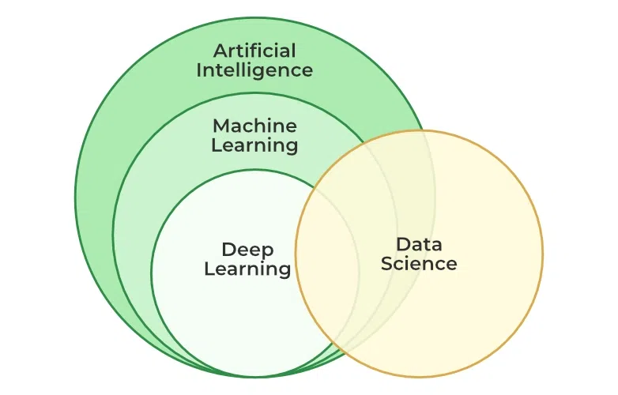
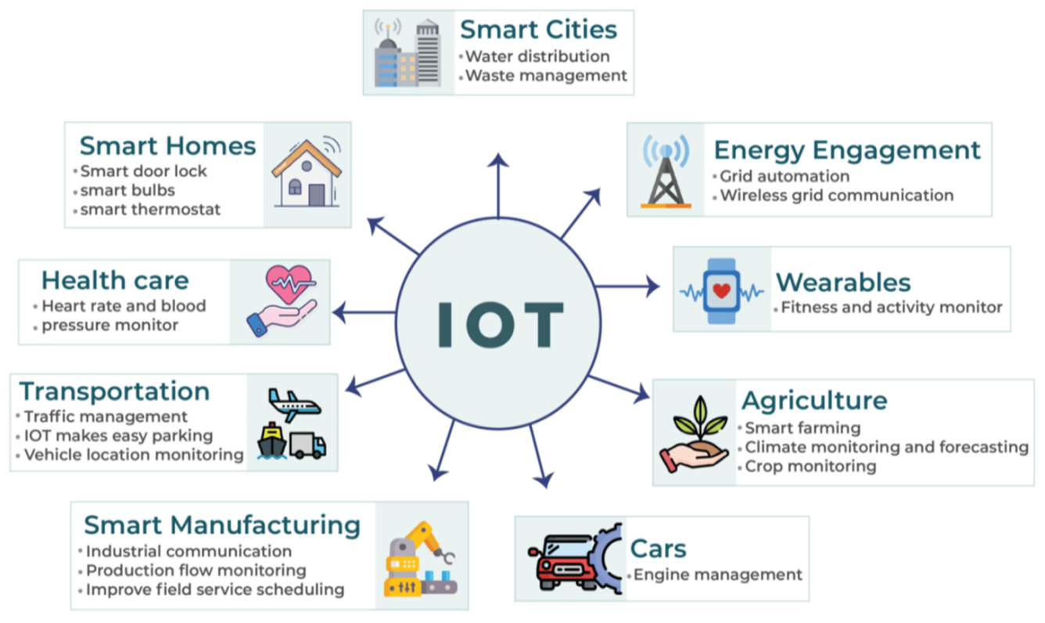
INTRODUCTION
(Cont’D)
Machine learning is a subset of Artificial Intelligence that enables computers to learn from data and make decisions or predictions without being explicitly programmed to do so.
The Internet of Things (IoT) is a network of physical objects that are connected and can exchange data and information with each other and other systems over the internet.
Figure 5: AI domain
Figure 6: IoT use cases

Slide 5
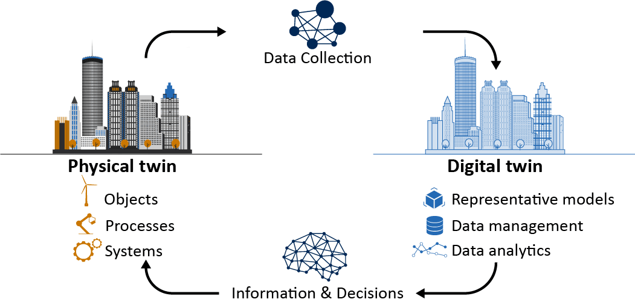
INTRODUCTION
(Cont’D)
A Digital Twin is a virtual replica of a physical object and its surroundings that enables real-time monitoring, analysis, and simulation.
create a 3D digital counterpart that mirrors the behavior, performance, and characteristics of its physical counterpart and its surroundings.
Figure 7: Digital Twin

Slide 6
OBJECTIVES
To build and implement a machine learning model capable of accurately detecting PV faults.
To use IoT device and web-based software for real-time data collection from the PV system and detect fault.
To create a digital twin model of the solar power plant and integrate it with the IoT software for enhanced monitoring and fault detection.

Slide 7
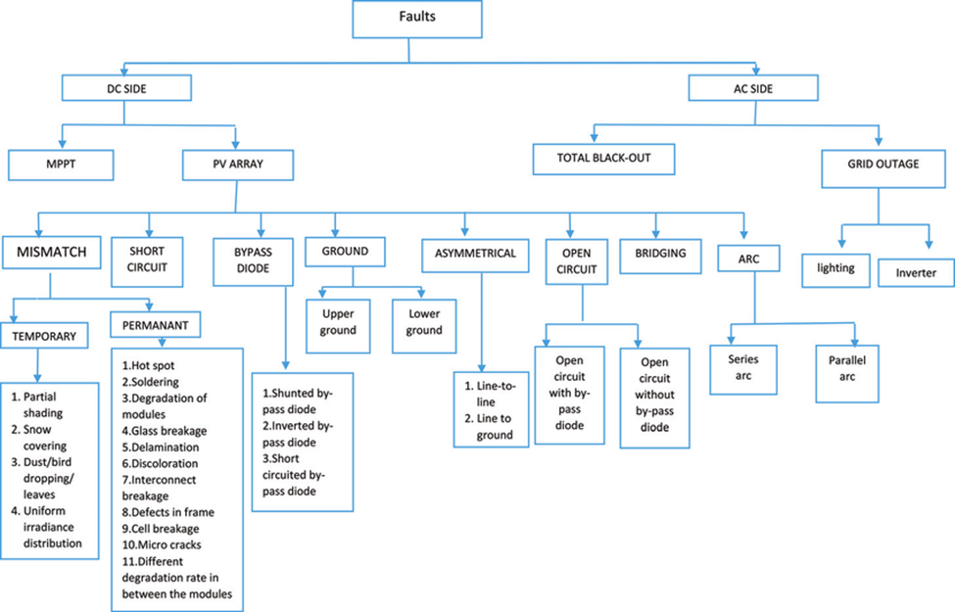
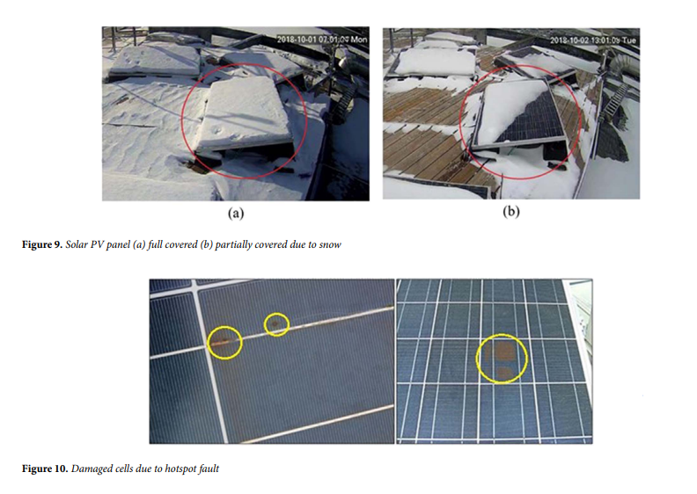
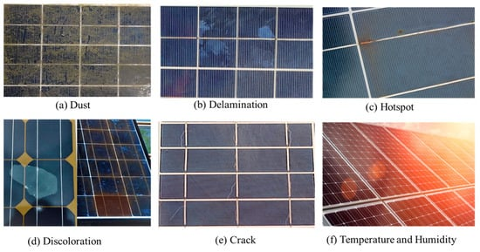
METHODOLOGY
Figure 7: Classification of faults in DC and AC side of PV systems
Figure 8: PV various fault

Slide 8
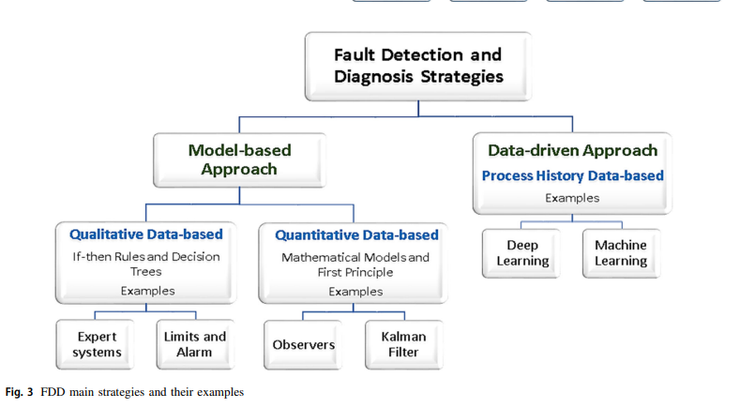
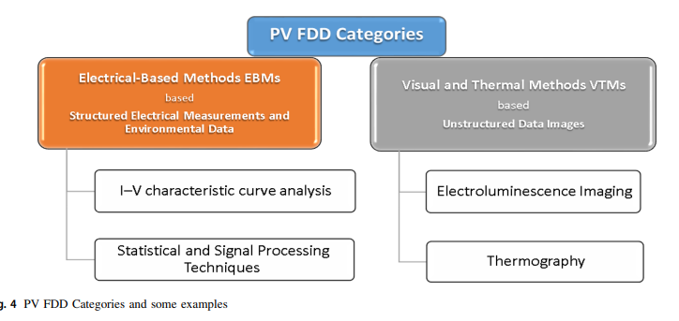
METHODOLOGY
(Cont’D)
Figure 9: Fault detection techniques types

Slide 9
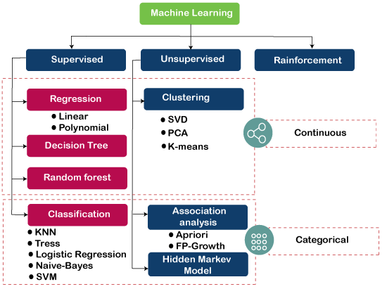
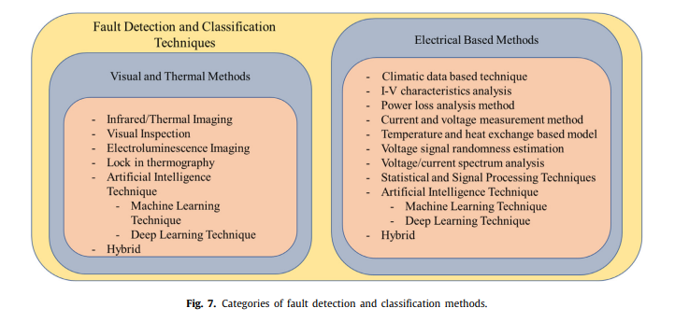

METHODOLOGY
(Cont’D)
Figure 10: Categories of fault detection and classification methods
Figure 11: Categories of Machine Learning

Slide 10
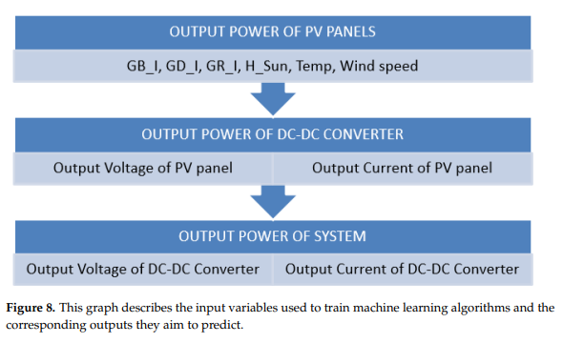
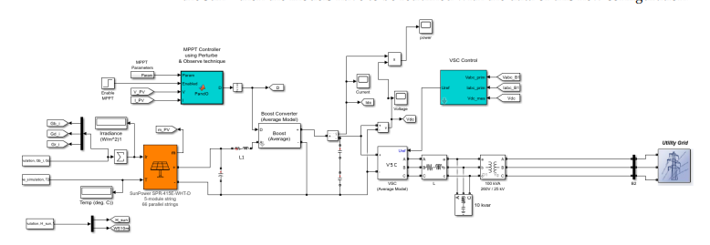
METHODOLOGY
(Cont’D)
SIMULINK Model to create treaning dataset to train Machine Learning Model
Using 2 KW Solar Power Plant of Department of Energy Science and Engineering,KUET
Generating
Data
Figure 12: (Sample)MATLAB SIMULINK model to generate training data

Slide 11
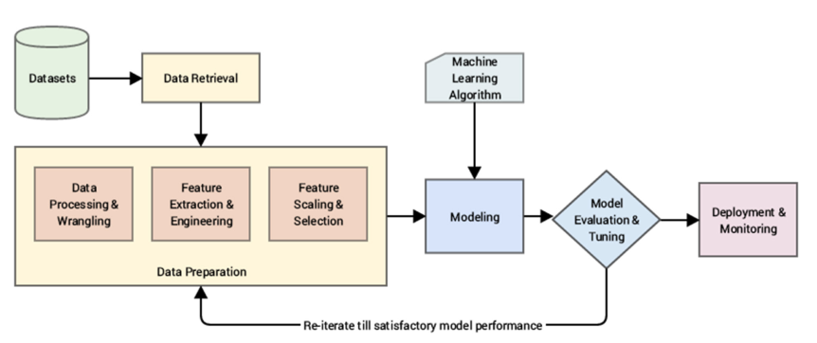
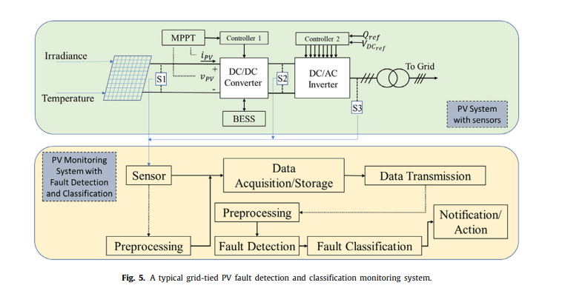
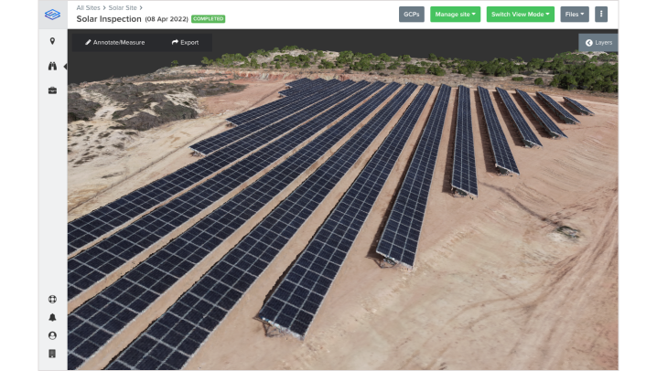
METHODOLOGY
(Cont’D)
Figure 13: Machine Learning workflow
Figure 14: (Sample) IoT to collect PV data
Figure 14: (Sample) Digital Twin

Slide 12

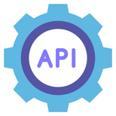
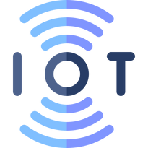







METHODOLOGY
(Cont’D)
Data
Database
PV Powerplant
IoT Device
Collect data
Web-based Software
Digital Twin
Training Data
ML model
Figure 15: System architecture

Slide 13
WORK PLAN
May
July
Aug
Sept
Oct
Dec
Feb
Literature Study
MATLAB Model Building
ML model Building
IoT and Digital Twin Integration
Report Writing
Notes:
© Copyright PresentationGO.com – Free Templates & Infographics for PowerPoint and Google Slides

Slide 14
THANK YOU
Presented By : Bidut Sharkar Shemanto

